Slide 1
How to Implement FEHash:
Step by Step Tutorial
Dang Mai Thao

Slide 2
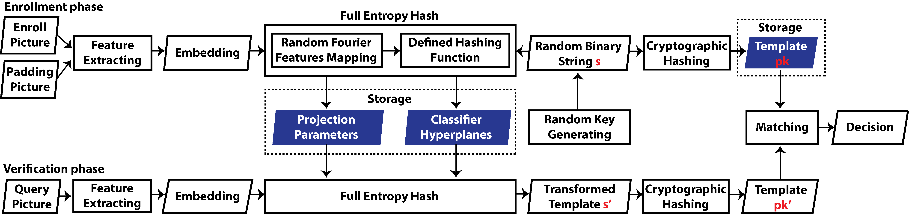
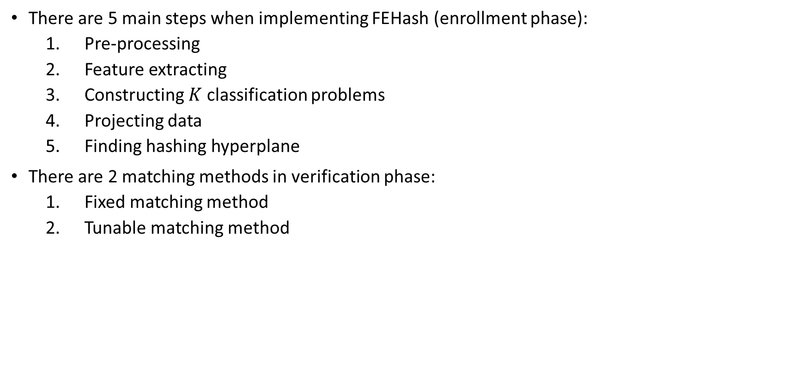
Overview
There are 5 main steps when implementing FEHash (enrollment phase):
  Pre-processing
  Feature extracting
  Constructing $K$ classification problems
  Projecting data
  Finding hashing hyperplane
There are 2 matching methods in verification phase:
  Fixed matching method
  Tunable matching method

Slide 3
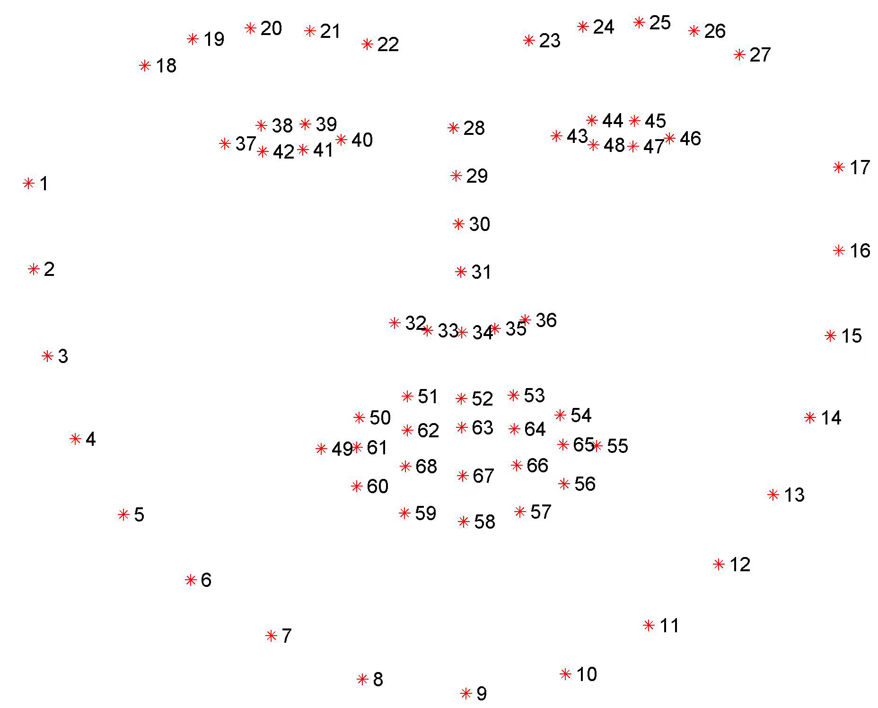
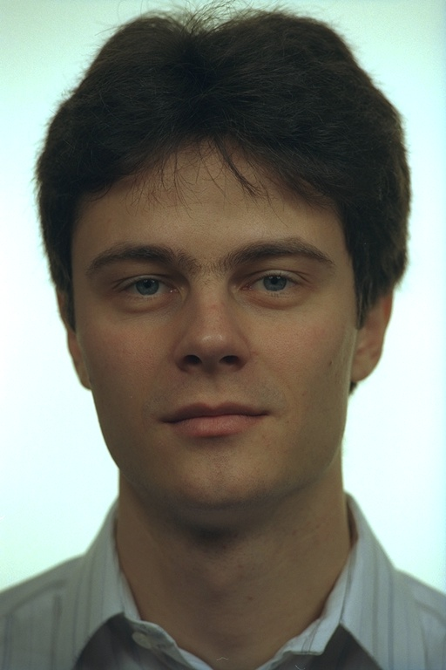


Enrollment phase: 1. Pre-processing
Eye alignment
68 landmarks
Eye center
localization
Face
detection
160x160 pixel crop
using Multi-task CNN
Source
Aligned face

Slide 4
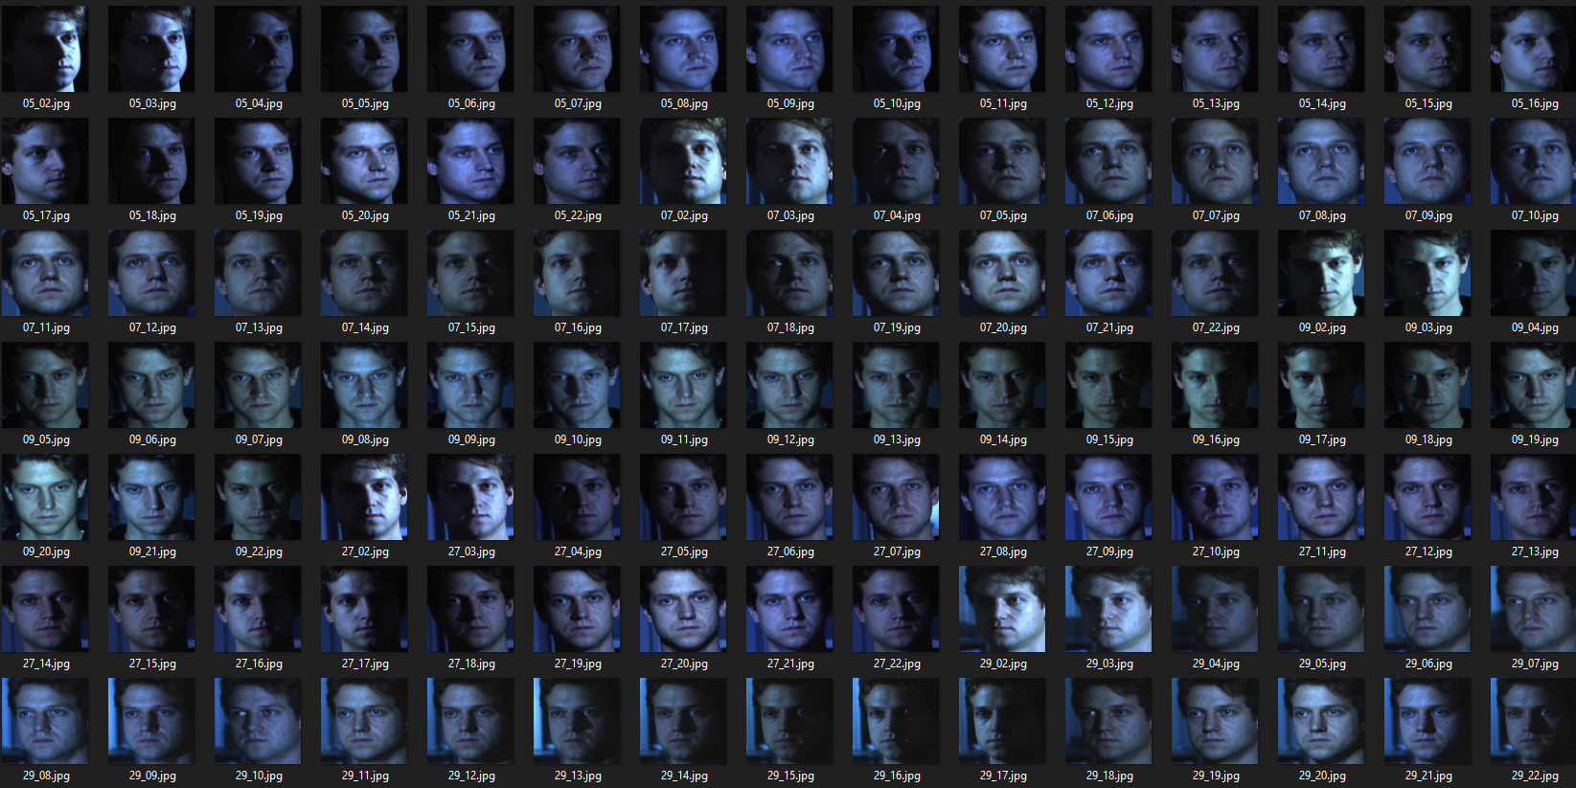
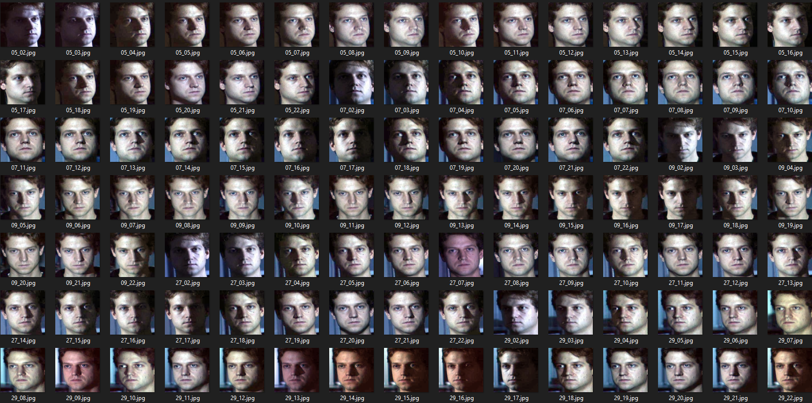
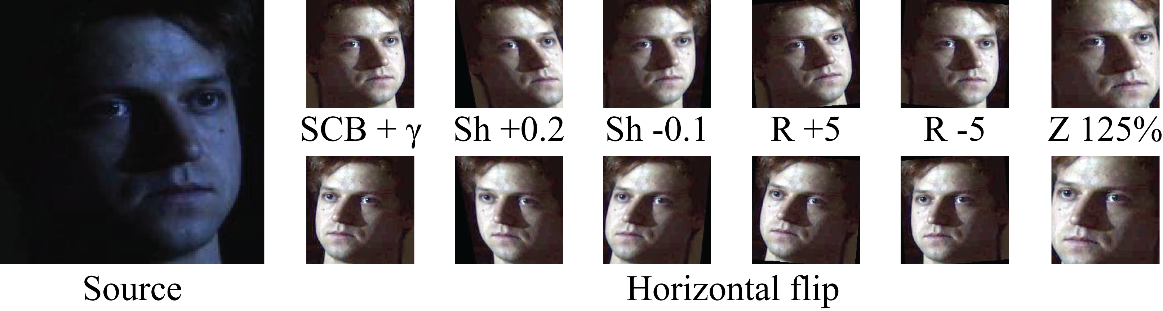
Enrollment phase: 1. Pre-processing
Color normalization
Augmentation

Slide 5
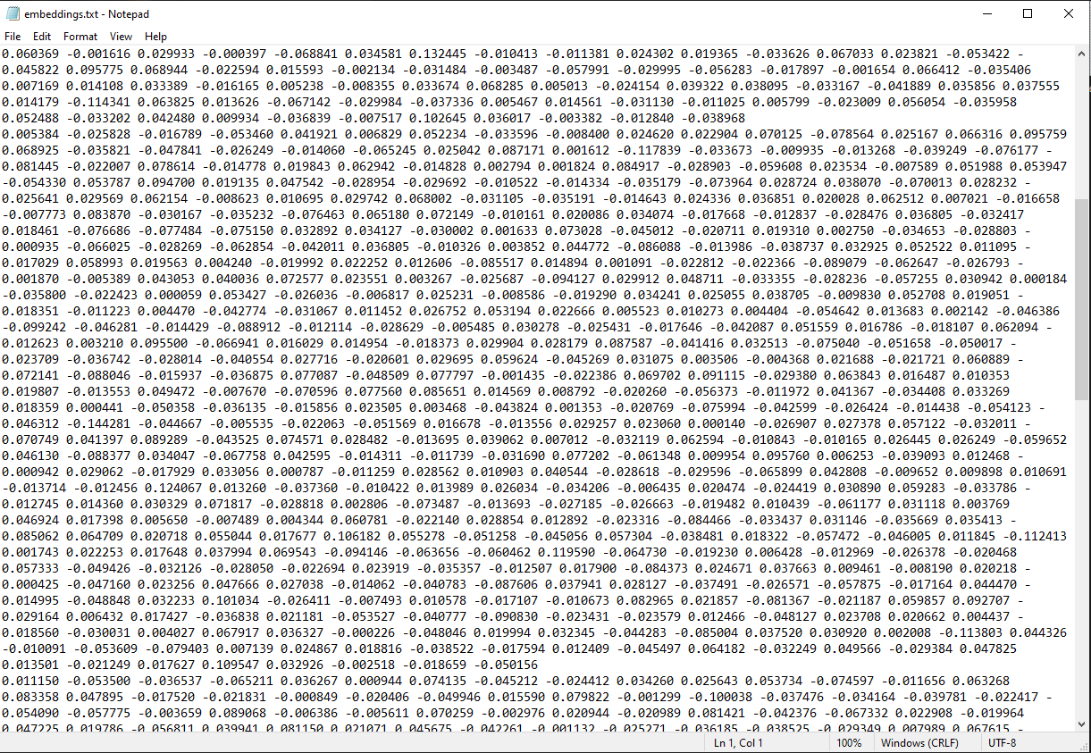
Enrollment phase: 2. Feature extracting
We use FaceNet to extract feature embeddings from face images

Slide 6
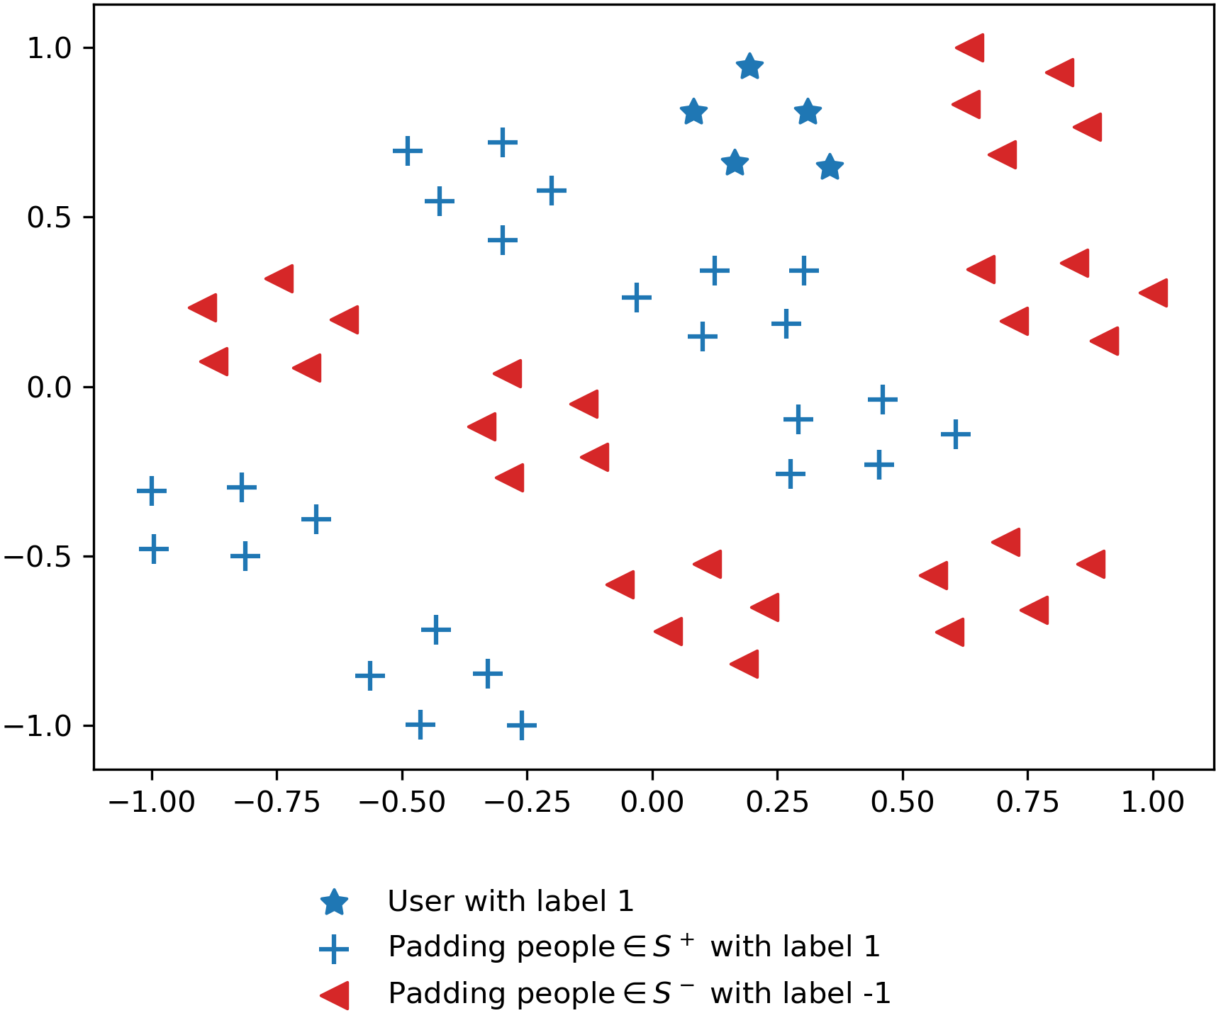
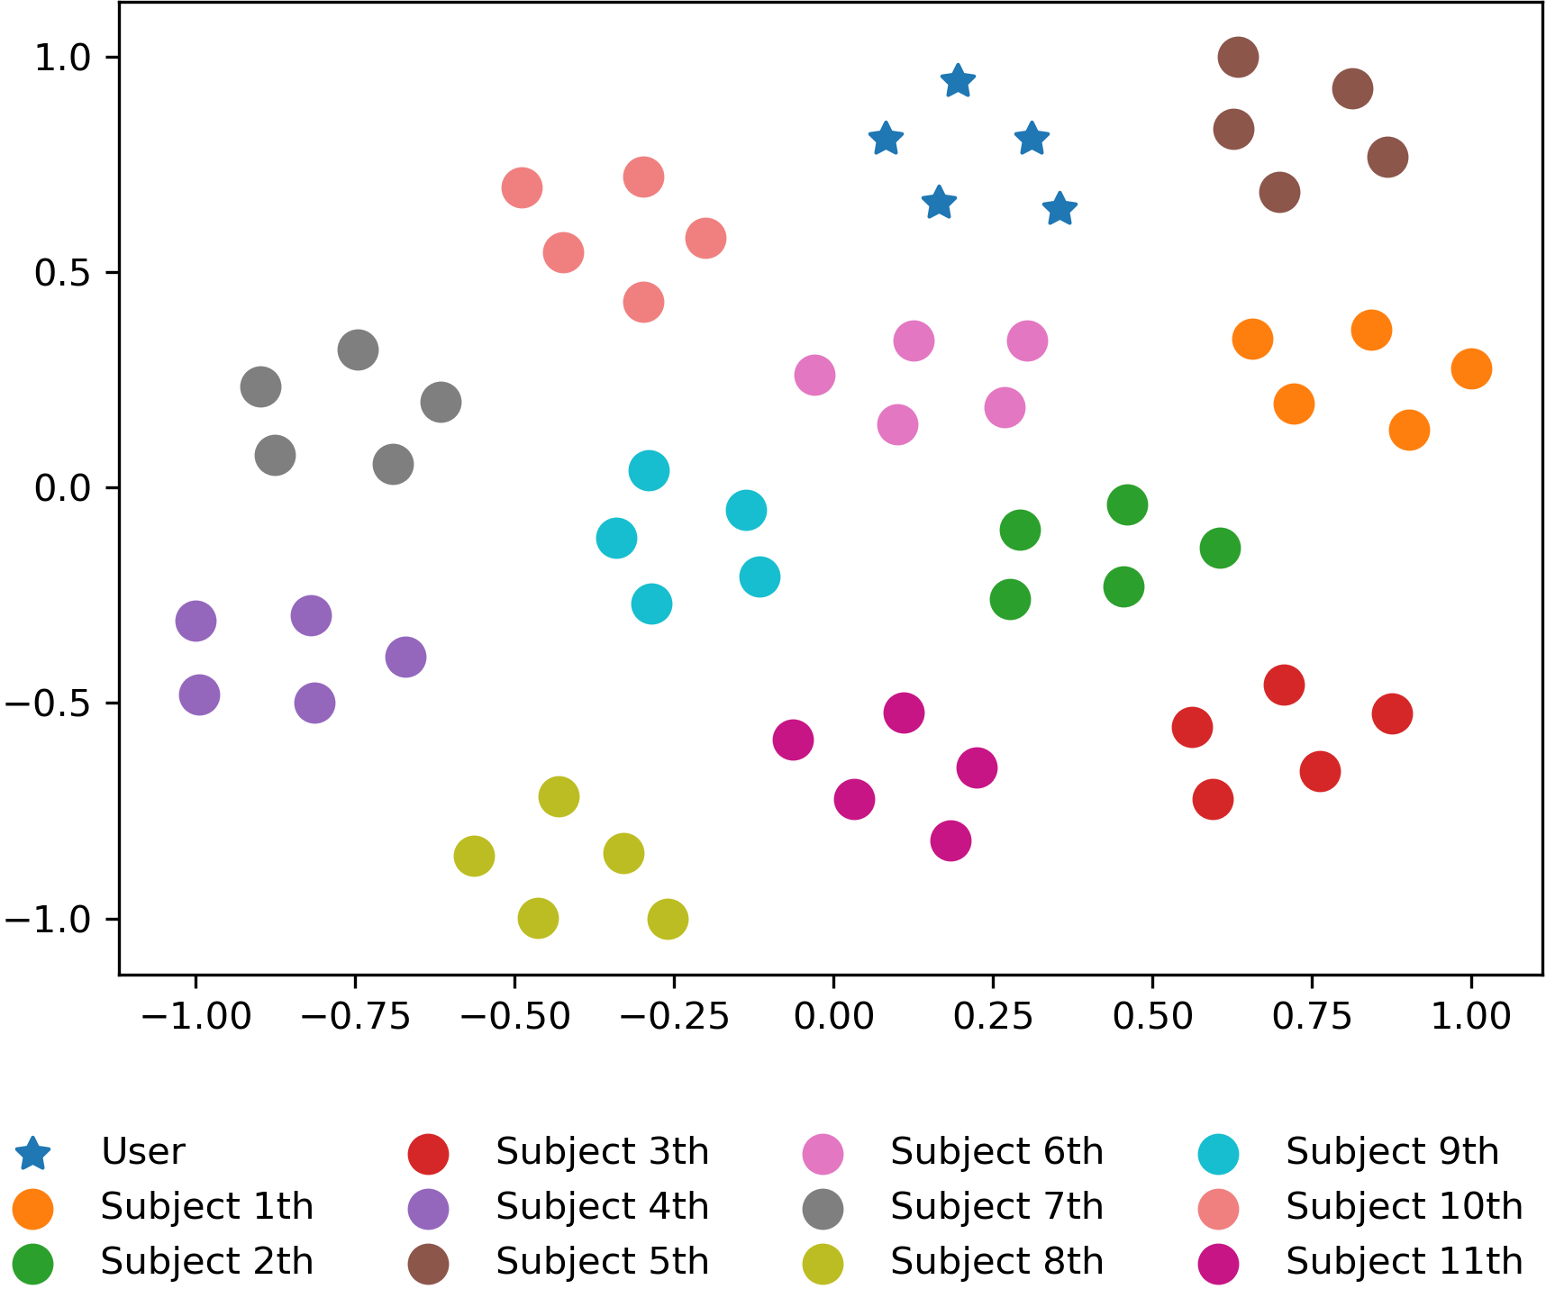
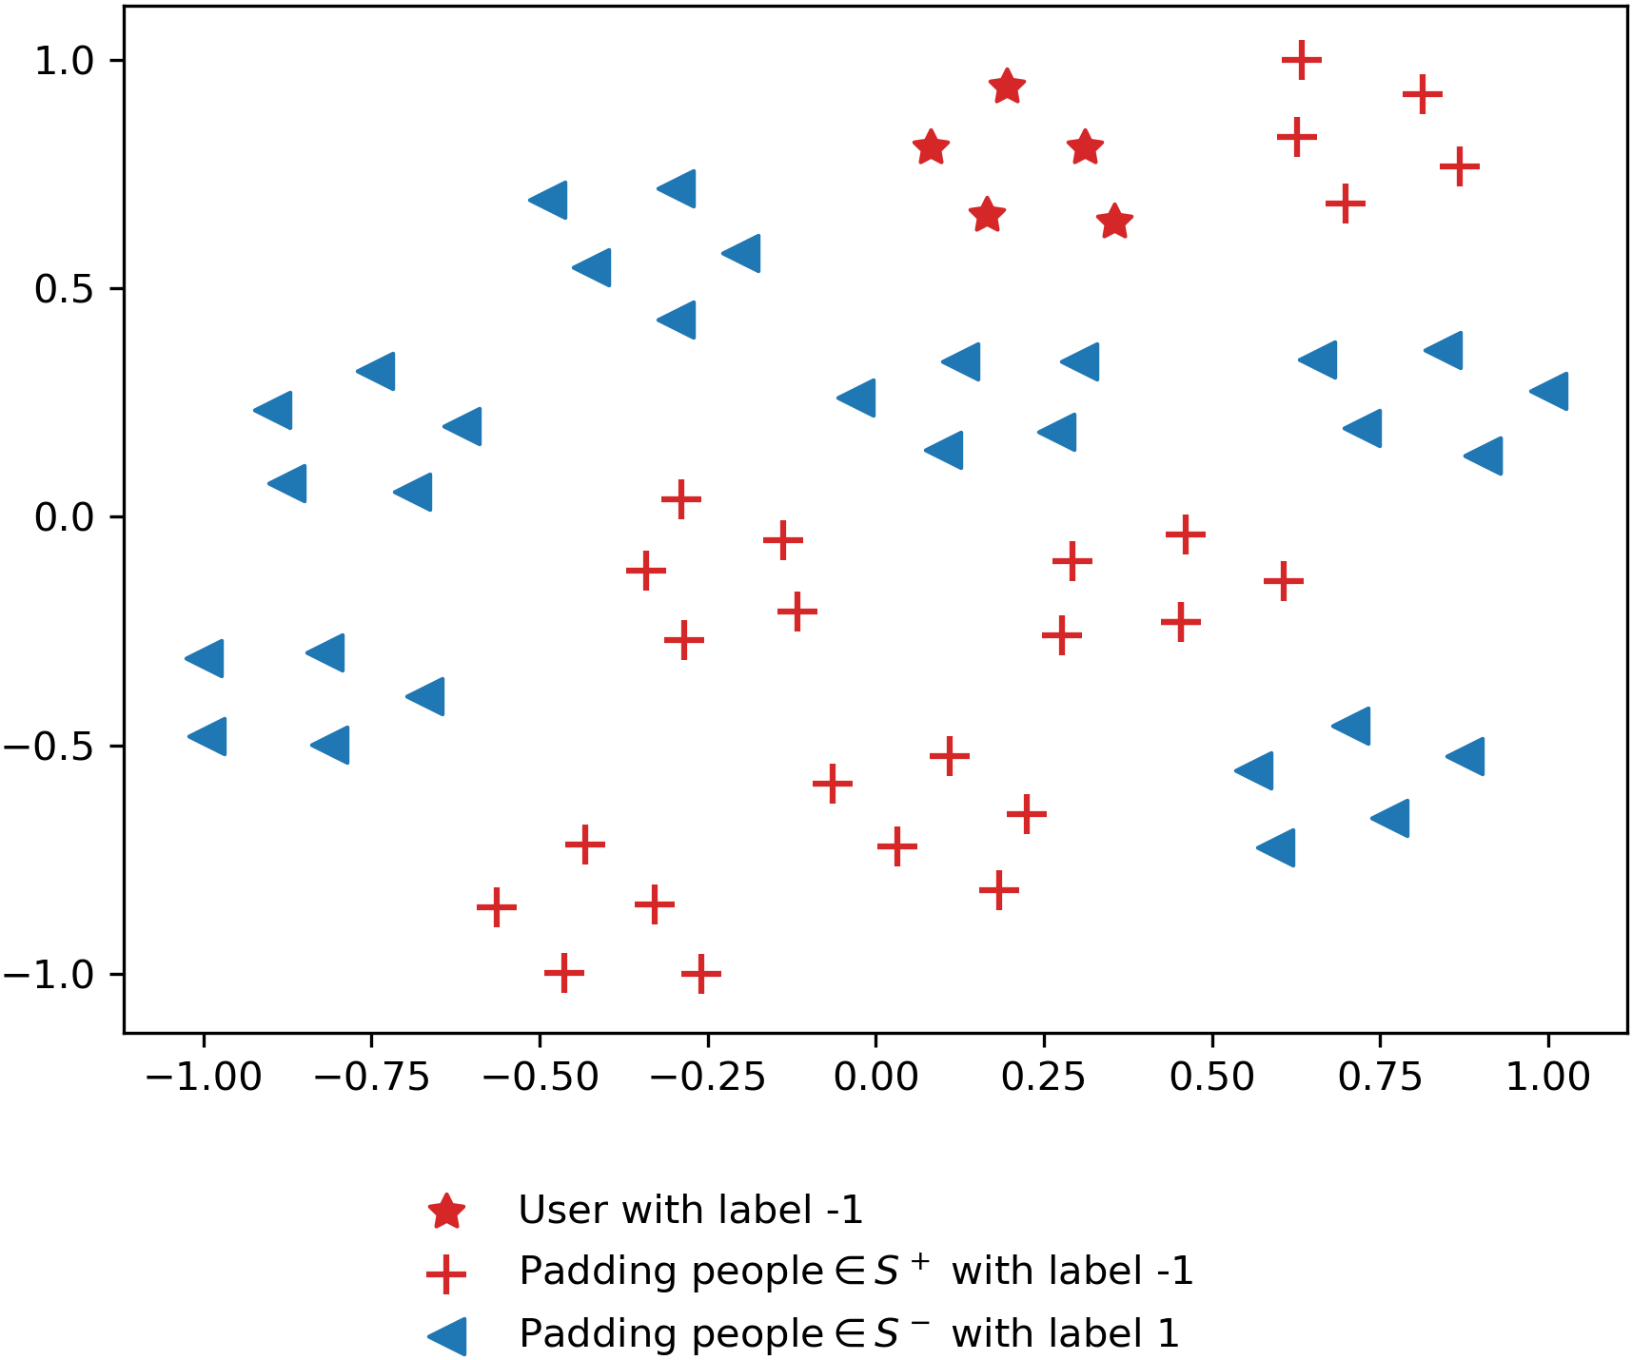
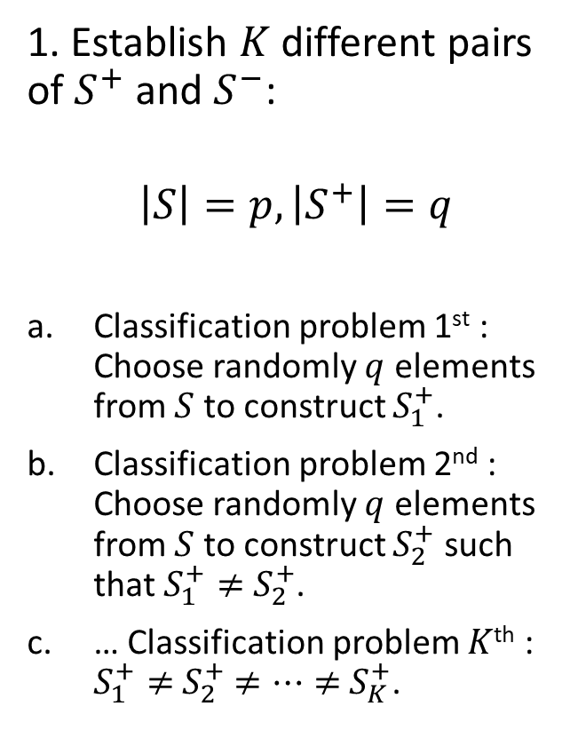

Enrollment phase: 3. Constructing $K$ problems
1. Establish $K$ different pairs of $S^{+}$ and $S^{−}$:
$$\left|S\right|=p, \left|S^{+}\right|=q$$
Classification problem 1st : Choose randomly $q$ elements from $S$ to construct $S_{1}^{+}$.
Classification problem 2nd : Choose randomly $q$ elements from $S$ to construct $S_{2}^{+}$ such that $S_{1}^{+}≠$ $S_{2}^{+}$.
… Classification problem $K$^{th} : $S_{1}^{+}≠$ $S_{2}^{+}$ $≠…≠$ $S_{K}^{+}$.
Source
1st
2nd

Slide 7
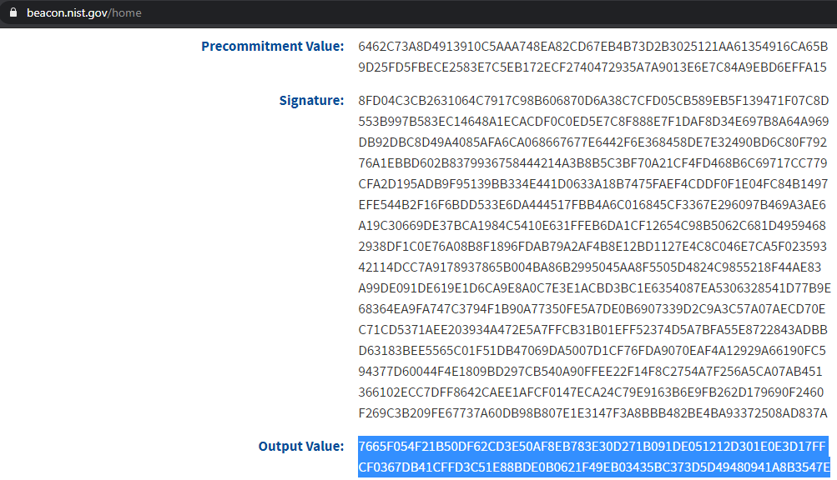
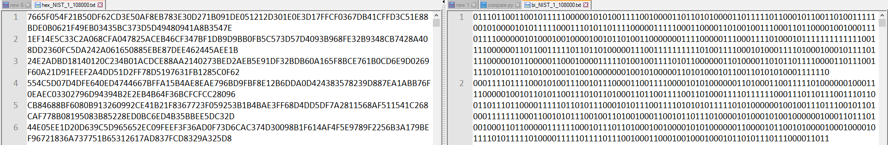
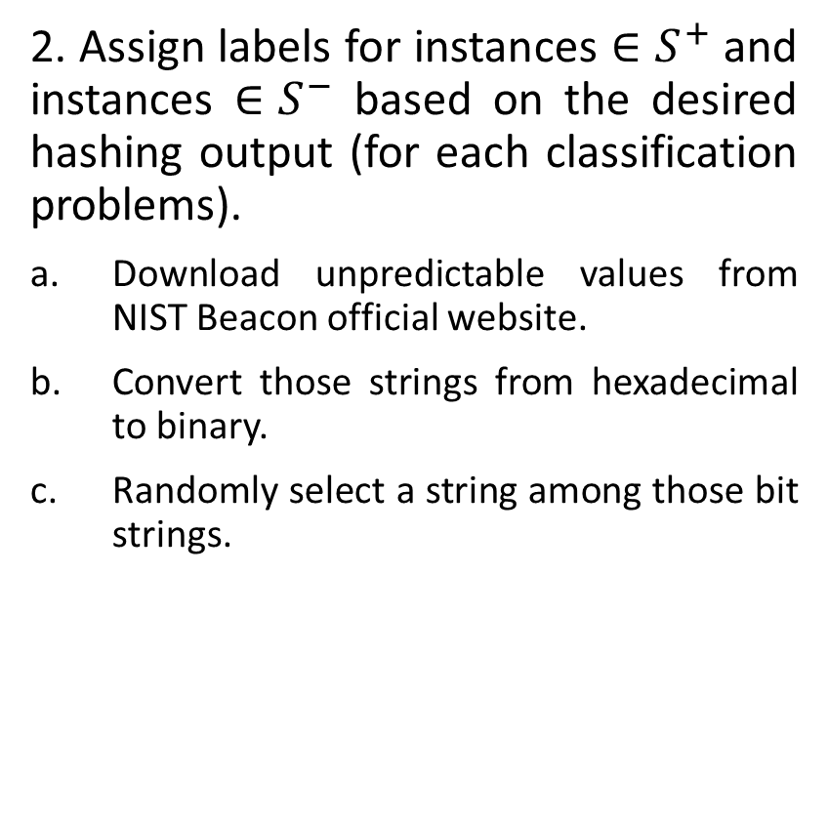
Enrollment phase: 3. Constructing $K$ problems
2. Assign labels for instances $∈S^{+}$ and instances $∈S^{−}$ based on the desired hashing output (for each classification problems).
Download unpredictable values from NIST Beacon official website.
Convert those strings from hexadecimal to binary.
Randomly select a string among those bit strings.

Slide 8
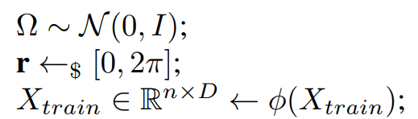
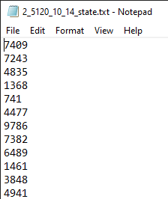
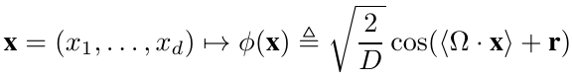
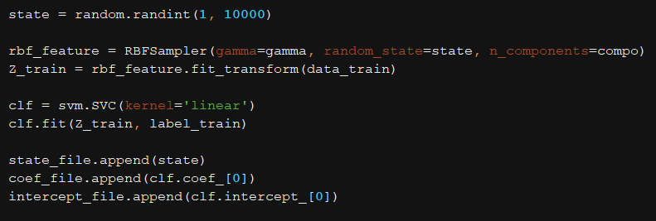
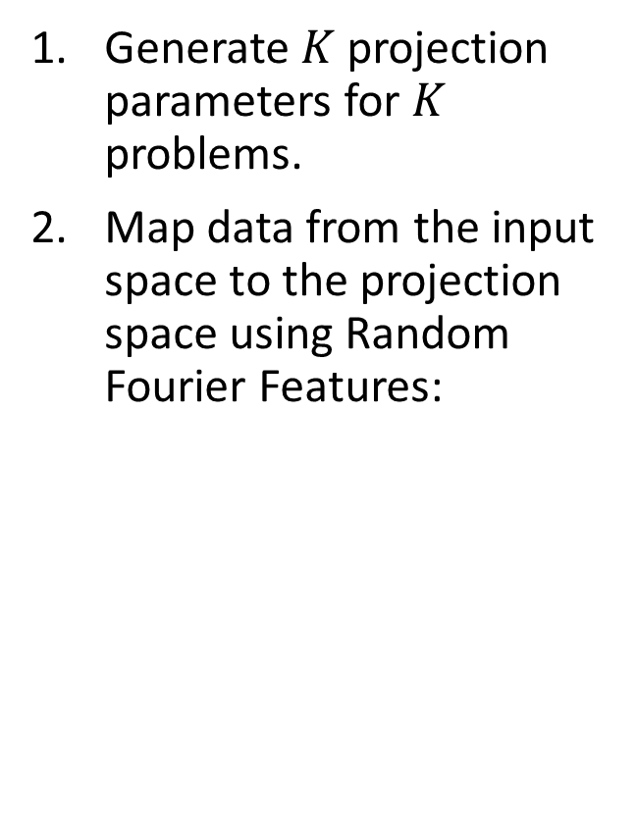
Enrollment phase: 4. Projecting data
Generate $K$ projection parameters for $K$ problems.
Map data from the input space to the projection space using Random Fourier Features:
Pseudo code
Python code

Slide 9
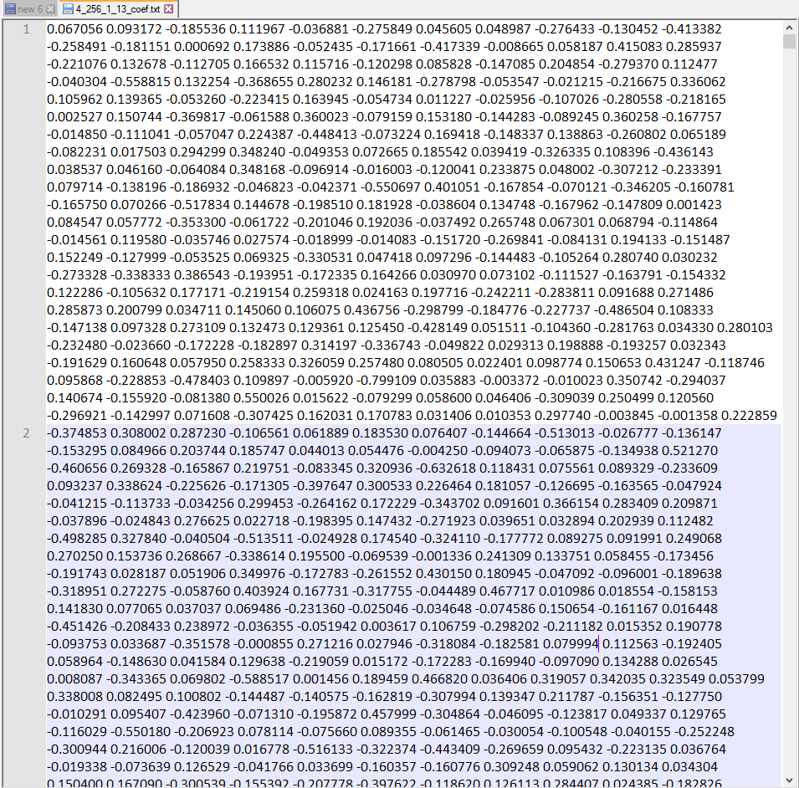
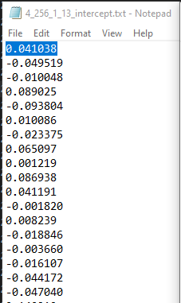
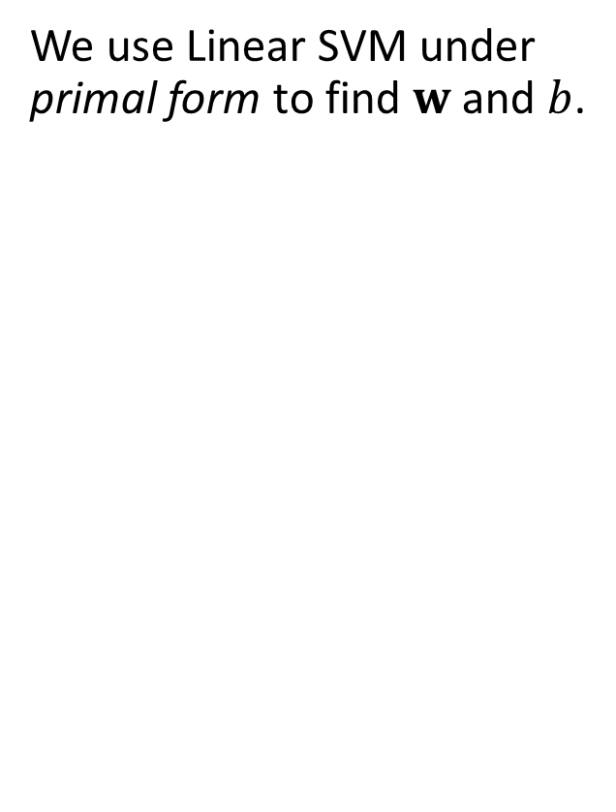


Enrollment phase: 5. Finding hyperplanes
Each line = a single $w$
We use Linear SVM under primal form to find $w$ and $b$.
Each line = a single $b$
Python code

Slide 10
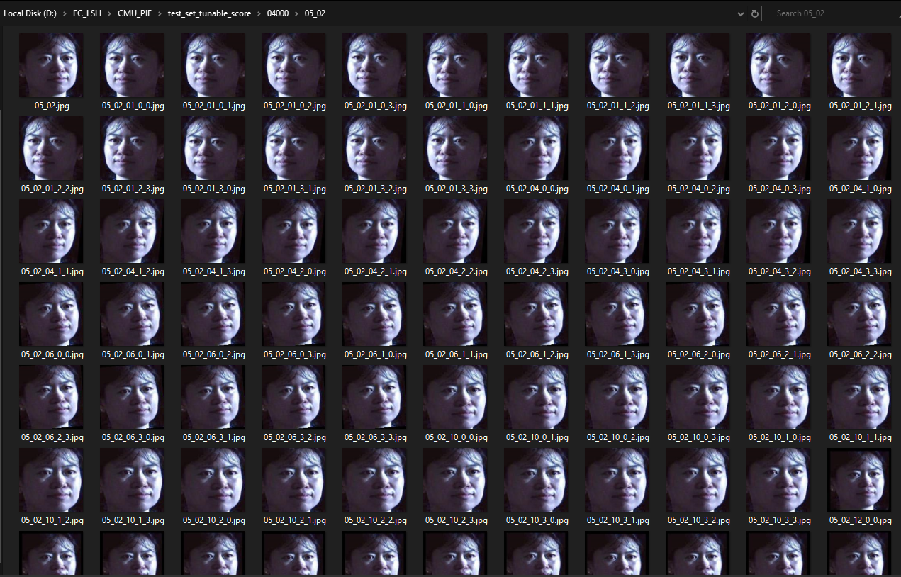
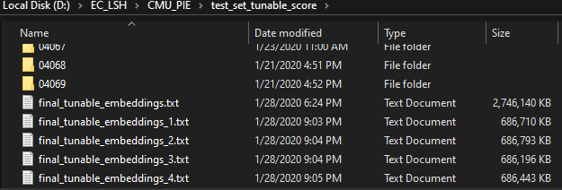
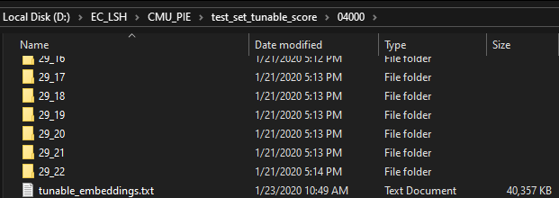
Verification phase: Tunable matching
For each picture in the testing set, we generate more 80 augmented pictures.

Slide 11
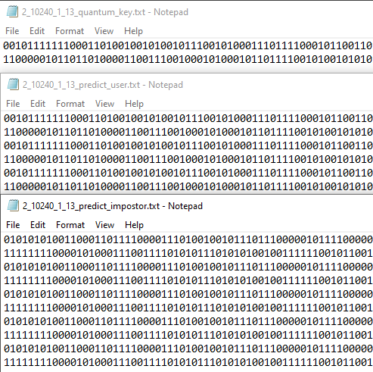
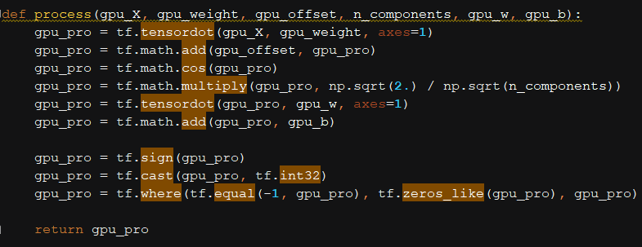
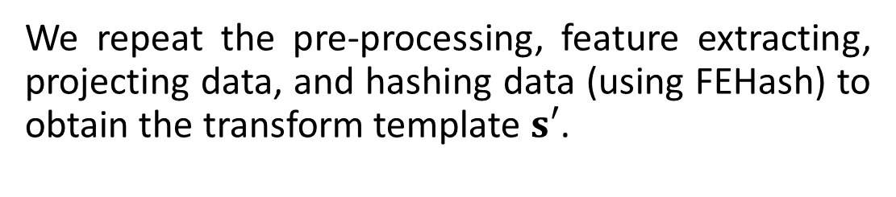
Verification phase:
We repeat the pre-processing, feature extracting, projecting data, and hashing data (using FEHash) to obtain the transform template $s′$.
Tensorflow code: Computing a single hashing result (${bit}_{i}∈s$)

